Slide 1

Geometry
Unit 3, Lesson 3 Congruent Angles in Parallel Lines Volume 1, pg. 138

Slide 2


Benchmark
MA.912.GR.1.1
Prove relationships and theorems about lines and angles. Solve mathematical and real-world problems involving postulates, relationships, and theorems of lines and angles.
volume 1, pg. 138

Slide 3
Integrated Mathematical Thinking and Reasoning Standards
MA.K12.MTR.1.1 Actively participate in effortful learning both individually and collectively.
MA.K12.MTR.4.1 Engage in discussions that reflect on the mathematical thinking of self and others.
MA.K12.MTR.5.1 Use patterns and structure to help understand and connect mathematical concepts.
MA.K12.MTR.6.1 Assess the reasonableness of solutions.
volume 1, pg. 138

Slide 4

Learning Target
I can use postulates and theorems to find unknown angle measures when parallel lines are intersected by a transversal.
volume 1, pg. 138

Slide 5

Warm-Up
volume 1, pg. 139

Slide 6
3.3.1 Warm-Up: Using Math in Making Guitars
Patrick Evans is a production manager at Maton Guitars in Australia. Country music star Keith Urban uses Maton guitars. The precision necessary in making each guitar requires mathematics, or “maths,” as Australians call it.
What was one thing you found interesting about the process of making a guitar?
volume 1, pg. 139

Slide 7

Guided Instruction
volume 1, pg. 139

Slide 8
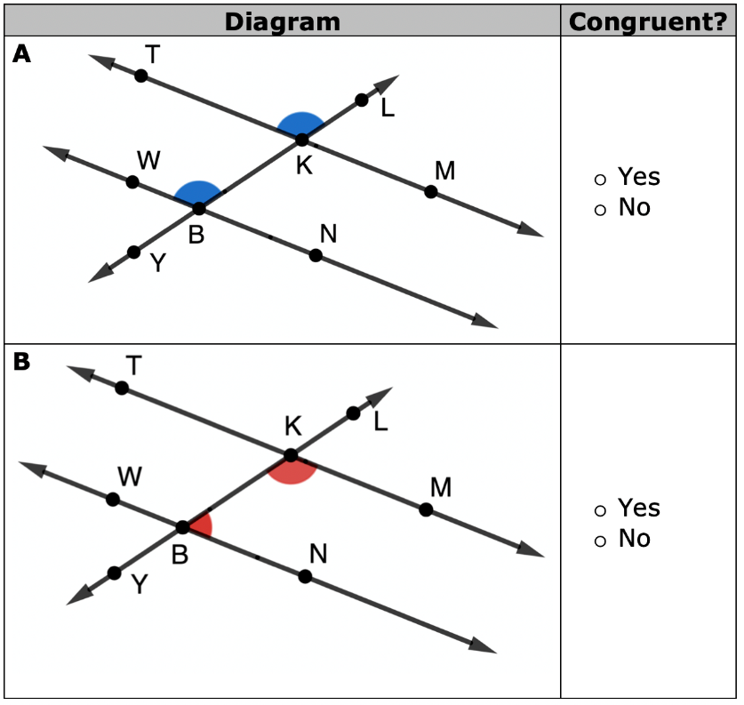
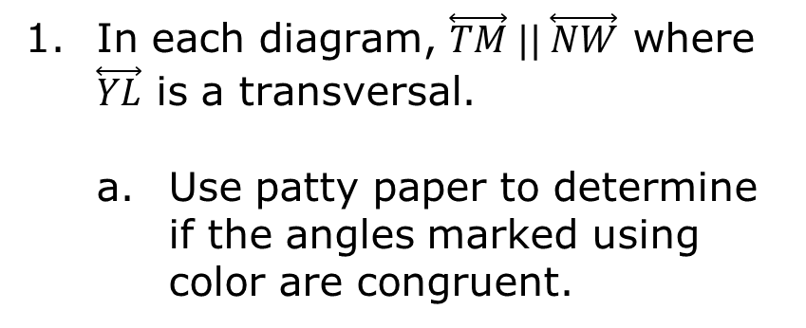
3.3.2 Guided Instruction: Angle Relationships
In each diagram, $\overset{⃡}{TM} || \overset{⃡}{NW}$ where $\overset{⃡}{YL}$ is a transversal.
Use patty paper to determine if the angles marked using color are congruent.
volume 1, pg. 139

Slide 9
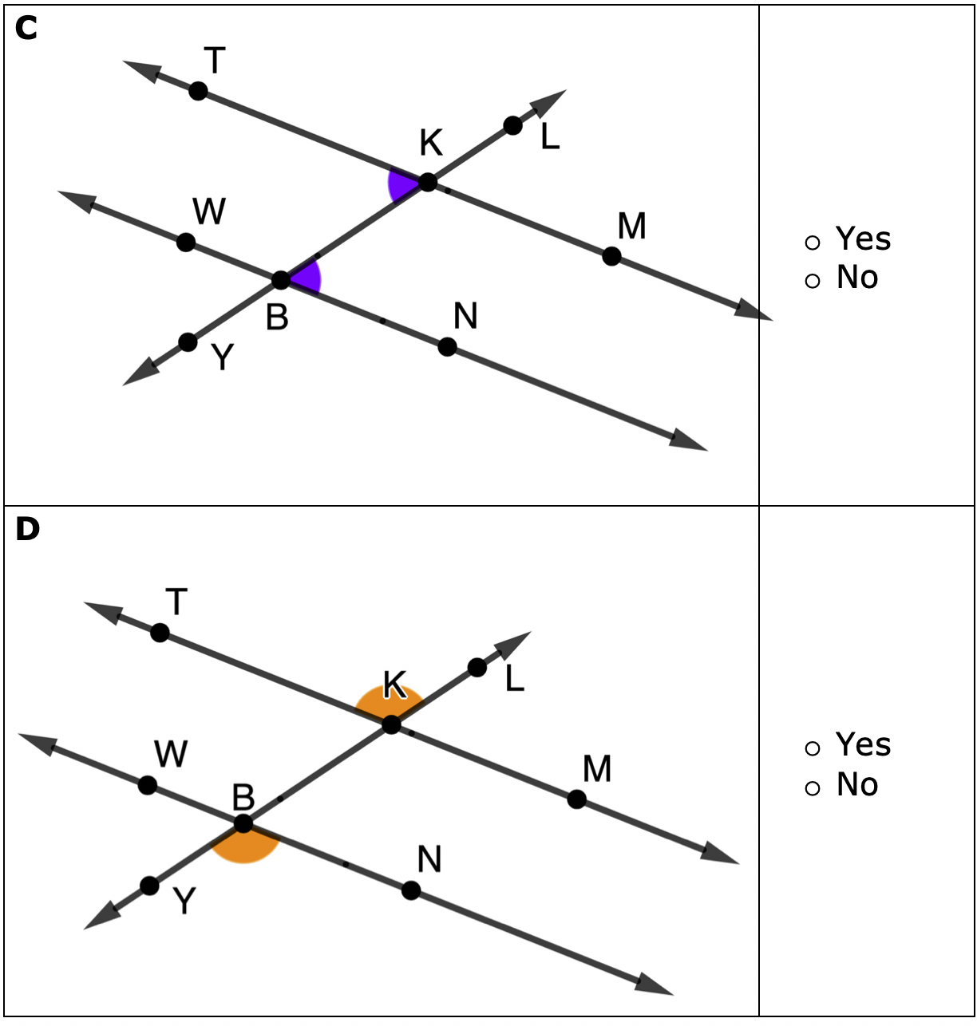
volume 1, pg. 140

Slide 10

Alternate Exterior Angles Theorem
If two parallel lines are intersected by a transversal, then alternate exterior angles are congruent.
Which diagram shows a pair of angles that are alternate exterior angles?
Diagram A
Diagram B
Diagram C
Diagram D
volume 1, pg. 140

Slide 11
Alternate Interior Angles Theorem
If two parallel lines are intersected by a transversal, then alternate interior angles are congruent.
Which diagram shows a pair of angles that are alternate interior angles?
Diagram A
Diagram B
Diagram C
Diagram D
volume 1, pg. 140

Slide 12
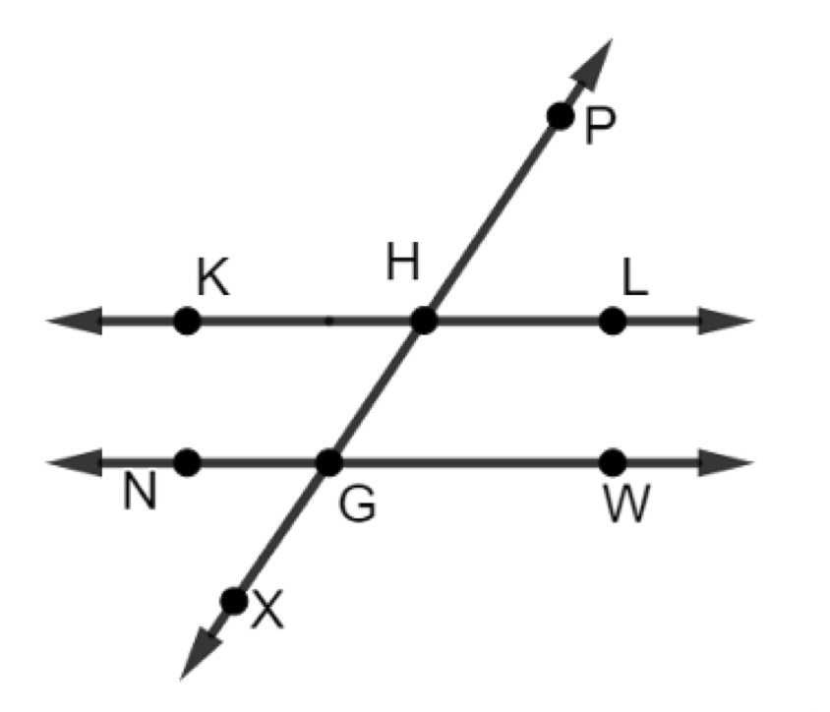
$\overset{⃡}{KL} || \overset{⃡}{NW}$, where $\overset{⃡}{XP}$ is a transversal.
Work with your partner to name each pair of angles as corresponding, alternate exterior, alternate interior angles, or none of these.
volume 1, pg. 141

Slide 13
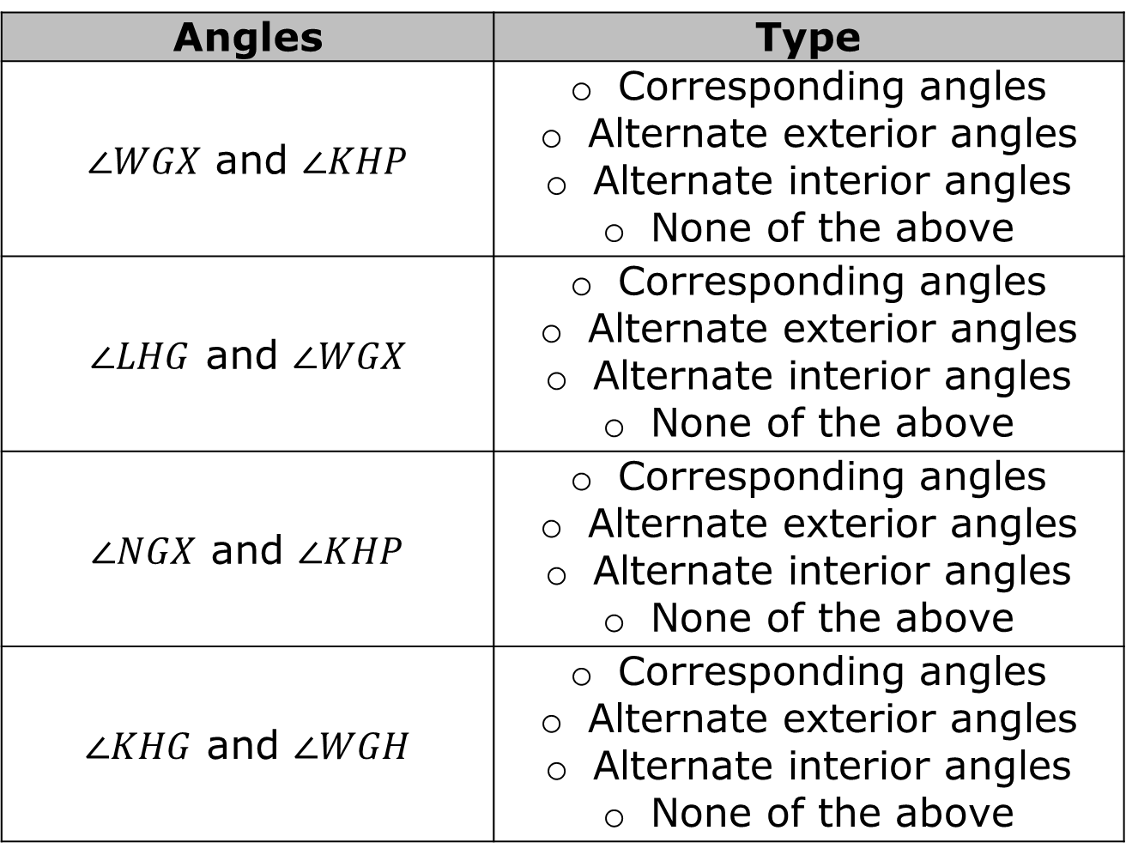
Angles | Type
$∠WGX$ and $∠KHP$ | Corresponding angles Alternate exterior angles Alternate interior angles None of the above
$∠LHG$ and $∠WGX$ | Corresponding angles Alternate exterior angles Alternate interior angles None of the above
$∠NGX$ and $∠KHP$ | Corresponding angles Alternate exterior angles Alternate interior angles None of the above
$∠KHG$ and $∠WGH$ | Corresponding angles Alternate exterior angles Alternate interior angles None of the above
volume 1, pg. 141

Slide 14
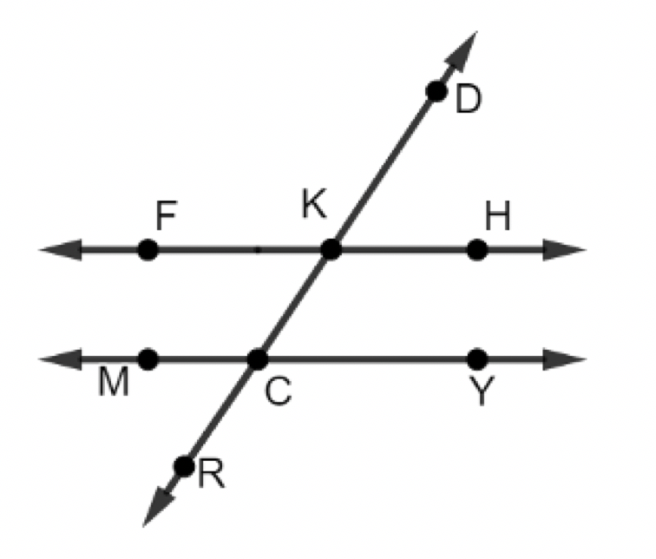
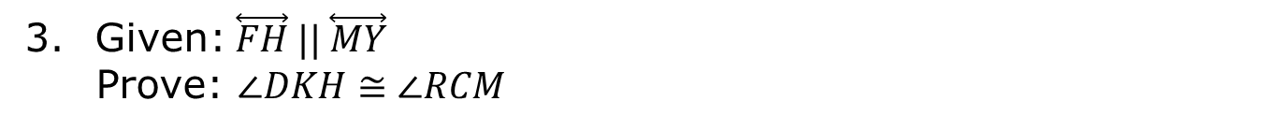
Given:$\overset{⃡}{FH} || \overset{⃡}{MY}$
Prove: $∠DKH≅∠RCM$
volume 1, pg. 141

Slide 15
Fill in the table to complete the proof.
Statement | Reason
1. | 1. Given
2. | 2. Vertical angles are congruent.
3. | 3.
4. | 4. Transitive Property of Congruence
volume 1, pg. 141

Slide 16

Try It
volume 1, pg. 142

Slide 17

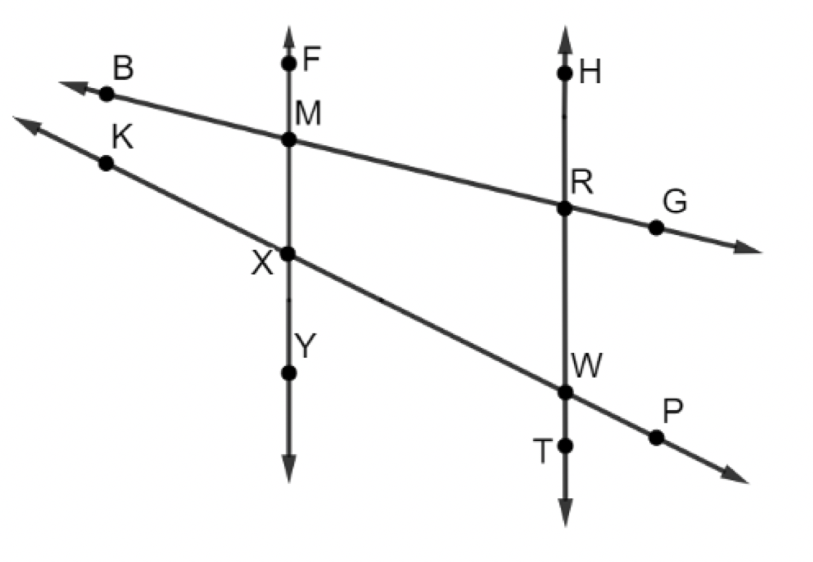
3.3.3 Try It: Angles and Parallel Lines
$\overset{⃡}{FY} || \overset{⃡}{HT}$ where $\overset{⃡}{BG}$ and $\overset{⃡}{KP}$ are transversals and $m∠BMF=76°$ and $m∠KXY=117°$.
volume 1, pg. 142

Slide 18
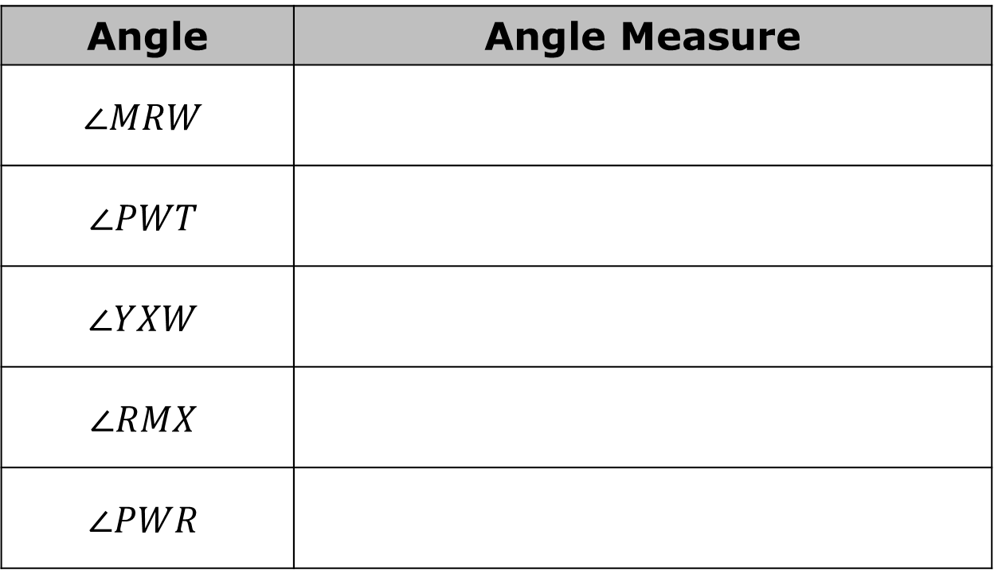
Complete the table.
Angle | Angle Measure
$$∠MRW$$
$$∠PWT$$
$$∠YXW$$
$$∠RMX$$
$$∠PWR$$
volume 1, pg. 142

Slide 19
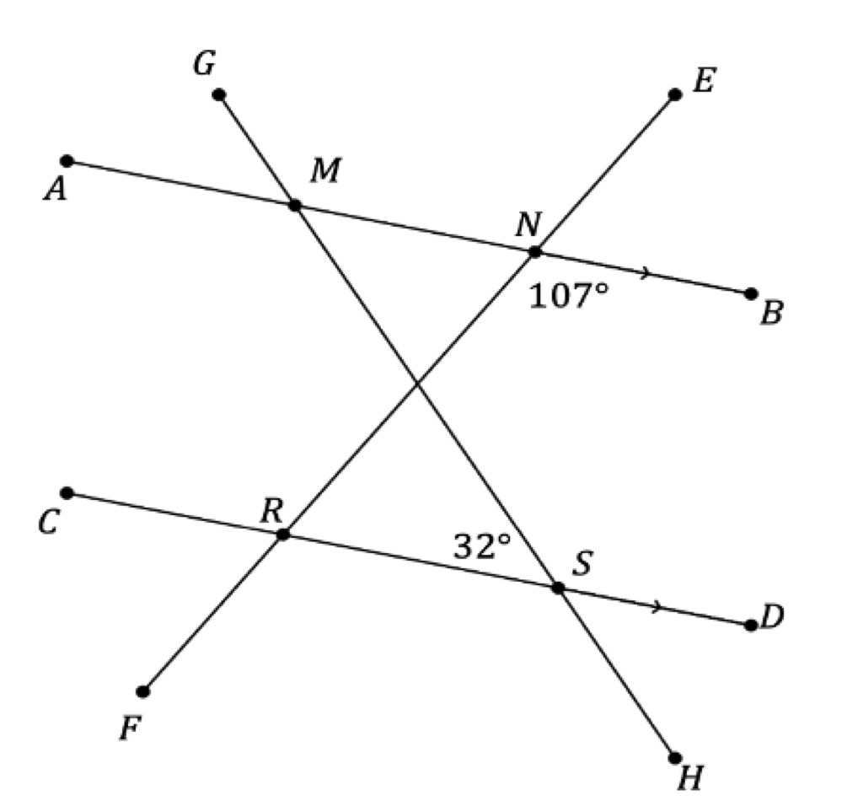
$\overline{AB} || \overline{CD}$ where $\overline{GH}$ and $\overline{EF}$ are transversals and $m∠BNR=107°$ and $m∠RSM=32°$.
volume 1, pg. 142

Slide 20
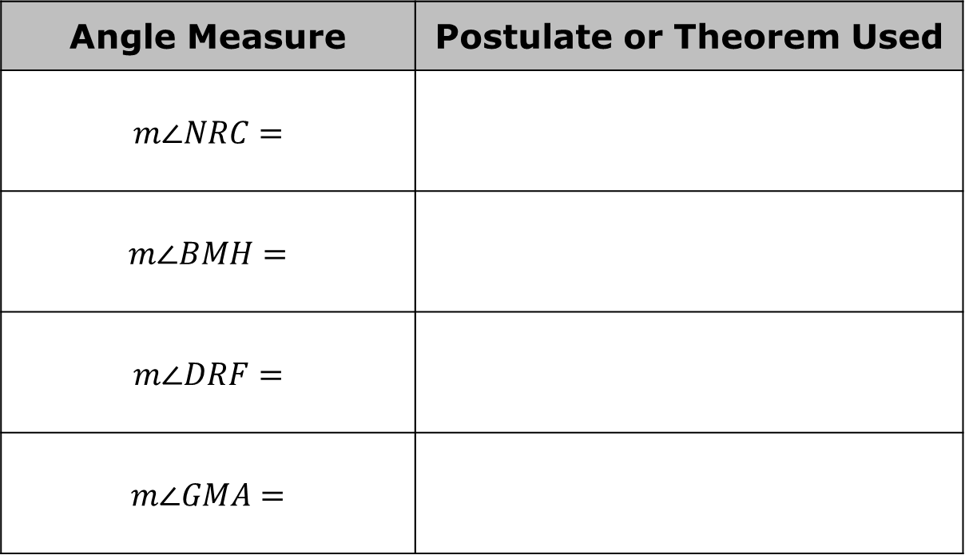
Complete the table.
Angle Measure | Postulate or Theorem Used
$$m∠NRC=$$
$$m∠BMH=$$
$$m∠DRF=$$
$$m∠GMA=$$
volume 1, pg. 142

Slide 21

Your Turn
volume 1, pg. 143

Slide 22
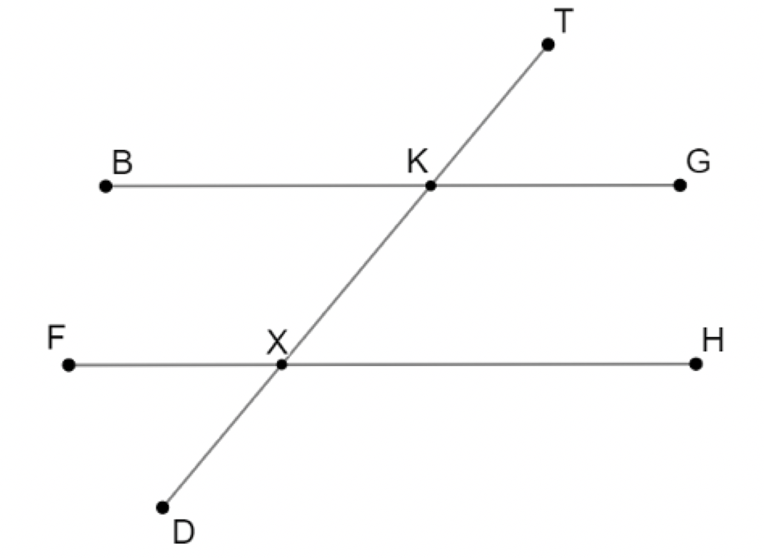
3.3.4 Your Turn!
$\overline{BG}∥\overline{FH}$ where $\overline{TD}$ is a transversal and $m∠HXD=134°$.
volume 1, pg. 143

Slide 23
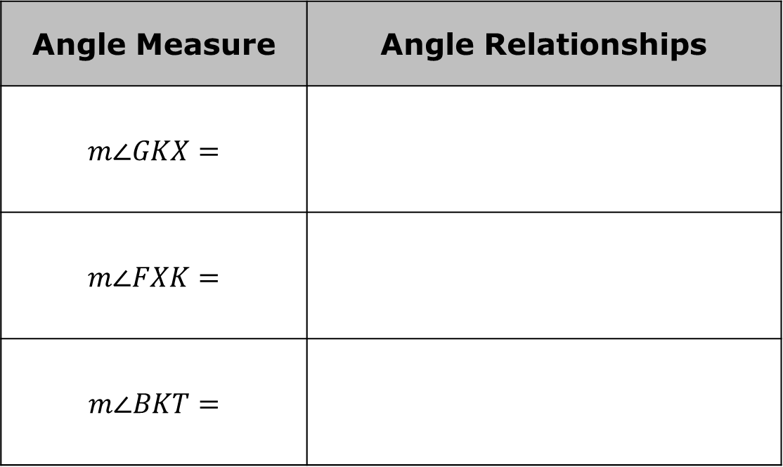
Find the measure of each angle. Then, state the angle relationships used to determine the value.
Angle Measure | Angle Relationships
$$m∠GKX=$$
$$m∠FXK=$$
$$m∠BKT=$$
volume 1, pg. 143

Slide 24

Wrap-Up
volume 1, pg. 143

Slide 25
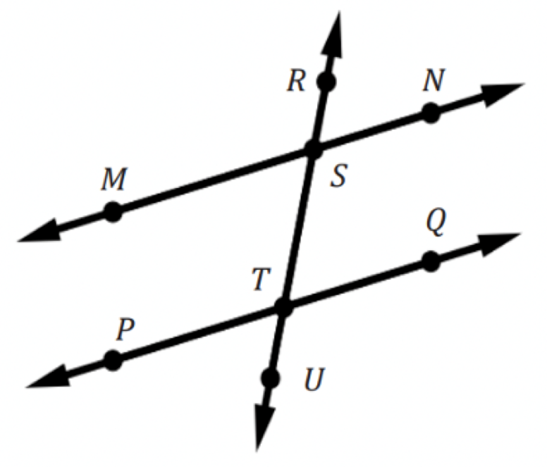
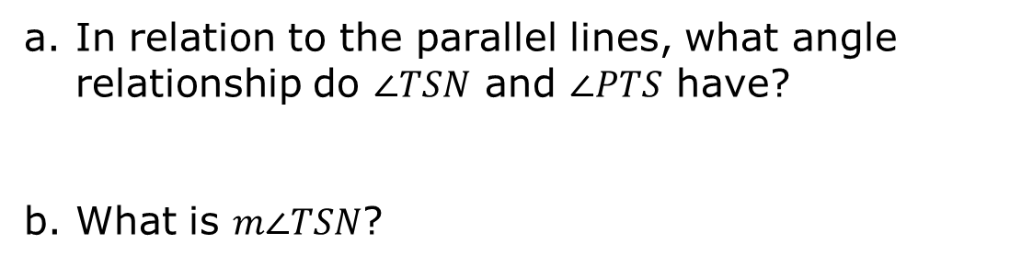
3.3.5 Wrap-Up: Ticket Out the Door
$\overset{⃡}{MN} ∥ \overset{⃡}{PQ}$ and $m∠PTS=100°$.
In relation to the parallel lines, what angle relationship do $∠TSN$ and $∠PTS$ have?
What is $m∠TSN$?
volume 1, pg. 143

